Slide 1

21ECSC210
Exploratory Data Analysis Course Project: Phase - I Review
Covid-19 Statewise Vaccine Analysis
Department of Computer Science and Engineering,
KLE Technological University’s Dr. M. S. Sheshgiri College of Engineering and Technology, Belagavi

Slide 2
Details of the Team
Div:
Sl. No. | Name |  | SRN.
1 | Akhilesh joshi |  | 02FE22BCS013
2 | Dilipsingh Rajpurohit |  | 02FE22BCS035
3 | Sana Mulla |  | 02FE22BCS099
4 | Seeba Doddmani |  | 02FE22BCS116
Department of Computer Science and Engineering,
KLE Technological University’s Dr. M. S. Sheshgiri College of Engineering and Technology, Belagavi

Slide 3


Background
Coronaviruses, a diverse group of viruses, can lead to illnesses in both animals and humans. In humans, these viruses can cause a range of respiratory infections, from mild colds to more serious conditions like Middle East Respiratory Syndrome (MERS) and Severe Acute Respiratory Syndrome (SARS). The newest addition to this family of viruses is the one responsible for the COVID-19 disease, as identified by the World Health Organization.
Department of Computer Science and Engineering,
KLE Technological University’s Dr. M. S. Sheshgiri College of Engineering and Technology, Belagavi

Slide 4
Problem Statement
We aim to analyze the distribution and administration of COVID-19 vaccines across different states in India. It seeks to uncover regional disparities, assess vaccination rates, understand demographic trends, address challenges, and predict future vaccine needs. By doing so, the project aims to provide actionable insights to optimize vaccine deployment strategies and combat the pandemic effectively.
Department of Computer Science and Engineering,
KLE Technological University’s Dr. M. S. Sheshgiri College of Engineering and Technology, Belagavi

Slide 5
Dataset Details
The number of new cases are increasing day by day around the world. This dataset has information from the states and union territories of India at daily level.
Vaccination data comes from covid19india.
There are 7486 instances, i.e., Total Individuals Vaccinated .
Source URL : dataset19 [ appeared on Kaggle ]
The data was recorded from the beginning of pandemic to
20th April 2021
Department of Computer Science and Engineering,
KLE Technological University’s Dr. M. S. Sheshgiri College of Engineering and Technology, Belagavi

Slide 6
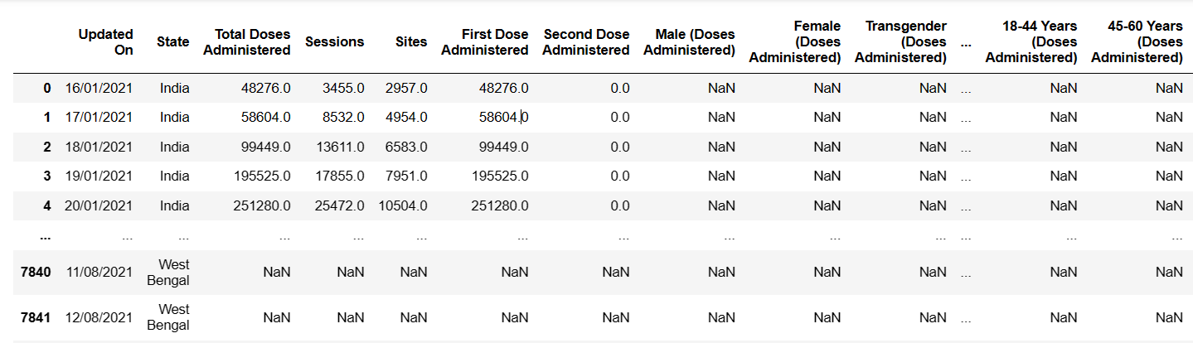
Snapshot of Dataset
7486 x 23
Department of Computer Science and Engineering,
KLE Technological University’s Dr. M. S. Sheshgiri College of Engineering and Technology, Belagavi

Slide 7
Knowing the Dataset
There are 24 features in the dataset.
Updated :
State : Name of the region
Total Doses Administered : Total number of vaccine doses administrated
Sessions : Total number of Sessions conducted
Sites : Total number of Sites in respective region
First Dose Administered : No of people who had taken the first dose
Second Dose Administered : No of people who had taken the Second dose
Male (Doses Administered) : No of Males who had taken the vaccine dose
Female (Doses Administered) : No of Females who had taken the vaccine dose
Transgender (Doses Administered) : No of Transgenders who had taken the vaccine dose
Covaxin (Doses Administered) : No of Covaxin doses
CoviShield (Doses Administered) : No of CoviShield doses
Sputnik V (Doses Administered) : No of Sputnik-V doses
AEFI : No of people having Adverse Events Following Immunization
Department of Computer Science and Engineering,
KLE Technological University’s Dr. M. S. Sheshgiri College of Engineering and Technology, Belagavi

Slide 8
Knowing the Dataset
18-44 Years (Doses Administered):No of doses administrated for people of age group of 18-44 years
45-60 Years (Doses Administered):No of doses administrated for people of age group of 45-60 years
60+ Years (Doses Administered):No of doses administrated for people aged 60+
18-44 Years(Individuals Vaccinated):No of people vaccinated of age group of 18-44 years
45-60 Years(Individuals Vaccinated): No of people vaccinated of age group of 45-60 years
Department of Computer Science and Engineering,
KLE Technological University’s Dr. M. S. Sheshgiri College of Engineering and Technology, Belagavi

Slide 9
Knowing the Dataset
60+ Years(Individuals Vaccinated): No of people vaccinated of age more than 60 years .
Male(Individuals Vaccinated): No of Male people vaccinated
Female(Individuals Vaccinated): No of Female people vaccinated
Transgender(Individuals Vaccinated): No of Transgenders vaccinated
Total Individuals Vaccinated: Total No of people vaccinated
Department of Computer Science and Engineering,
KLE Technological University’s Dr. M. S. Sheshgiri College of Engineering and Technology, Belagavi

Slide 10
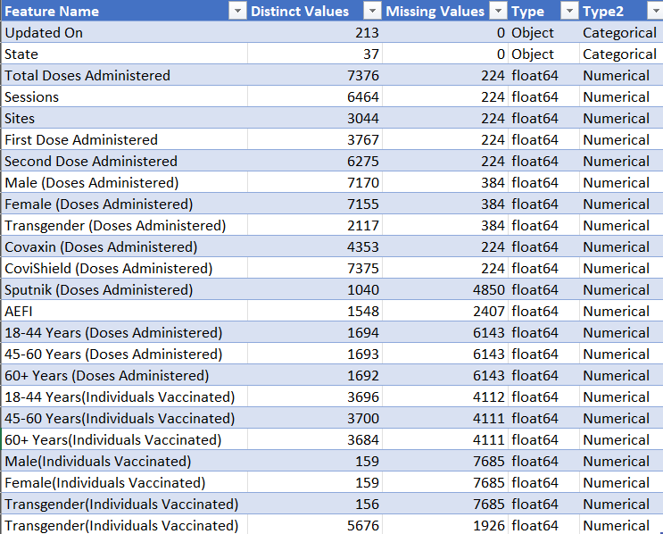
Feature Set Description
Department of Computer Science and Engineering,
KLE Technological University’s Dr. M. S. Sheshgiri College of Engineering and Technology, Belagavi

Slide 11
Proposed Hypothesis
What is the overall trend in COVID-19 vaccine administration across different states in India?
Which age group has received the highest number of vaccine doses, and how does vaccination coverage vary across different age groups?
What is the preference for different vaccine types (e.g., Covaxin, Covishield, Sputnik V) across different states?
Are there any demographic factors (e.g., gender, age) that influence vaccine uptake?
How does the number of vaccination sessions conducted impact the total number of vaccine doses administered?
Department of Computer Science and Engineering,
KLE Technological University’s Dr. M. S. Sheshgiri College of Engineering and Technology, Belagavi

Slide 12
Proposed Hypothesis
Is there any correlation between adverse events following immunization (AEFI) and the total number of vaccine doses administered
What is the average number of doses administered per session?
which state/region has the highest number of doses administered/
which state has the highest number of total individuals vaccinated?
Can we predict future vaccination trends based on historical data and demographic factors?
Department of Computer Science and Engineering,
KLE Technological University’s Dr. M. S. Sheshgiri College of Engineering and Technology, Belagavi

Slide 13
Implement Framework
Data Cleaning:
Handling Missing Values: Check for any missing values in the dataset and decide on an appropriate strategy to handle them, such as imputation or removal.
Data Transformation: Convert any categorical variables into numerical format if necessary for modeling. Ensure consistency in data types and formats across the dataset.
Outlier Detection and Treatment: Identify and handle any outliers in the data that may affect the analysis or modeling process.
Department of Computer Science and Engineering,
KLE Technological University’s Dr. M. S. Sheshgiri College of Engineering and Technology, Belagavi

Slide 14
Data analysis:
Histograms and Density Plots: Visualize the distributions of numerical variables (e.g., Total Doses Administered, First Dose Administered, etc.) using histograms or density plots. This will give you insights into the spread and central tendencies of the data.
Box Plots Use box plots to visualize the distribution of numerical variables across different categories (e.g., vaccine types) to identify any variations or outliers.
Bar Plots: For categorical variables (e.g., State), create bar plots to visualize the frequency distribution of each category.
Descriptive Statistics: Calculate summary statistics such as mean, median, mode, standard deviation, and quartiles for numerical variables to describe their central tendency and variability.
Department of Computer Science and Engineering,
KLE Technological University’s Dr. M. S. Sheshgiri College of Engineering and Technology, Belagavi

Slide 15
Data analysis:
Correlation Analysis: Compute correlation coefficients (e.g., heatmaps ) between numerical variables to identify any linear relationships. This can help you understand how different attributes are related to each other.
Hypothesis Testing: Conduct hypothesis tests to compare numerical variables across different categories (e.g., vaccine types, age groups) and determine if there are statistically significant differences.
Visualization and Interpretation:
Visualize the results of your data analysis using appropriate plots and charts (e.g., scatter plots, heatmaps, correlation matrices) to communicate your findings effectively.
Interpret the results of your analysis to draw insights and make data-driven decisions. For example, you might identify demographic factors that are associated with higher vaccination rates or vaccine preferences in different regions.
Department of Computer Science and Engineering,
KLE Technological University’s Dr. M. S. Sheshgiri College of Engineering and Technology, Belagavi

Slide 16
Implement Framework
Machine Learning :
Target Variable Definition/Classification: Define your target variable based on the objective of your analysis. For example, it could be predicting the total number of vaccine doses administered in the future or classifying regions based on vaccination coverage levels..
Department of Computer Science and Engineering,
KLE Technological University’s Dr. M. S. Sheshgiri College of Engineering and Technology, Belagavi

Slide 17
MOOC Course Details
Team No. : EDA-B1
Div: B
Sl. No. | Name | SRN. | Course Name | Course Link | Status
1 | Akhilesh Joshi | 02FE22BCS013 | Python for Data Science , AI and Development | Coursera | Ongoing
2 | Dilipsingh Rajpurohit | 02FE22BCS035 | Python for Data Science , AI and Development | coursera | Ongoing
3 | Sana Mulla | 02FE22BCS099 | Python for Data Science (2023) | Udemy | Ongoing
4 | Seeba Doddmani | 02FE22BCS116 | Python for Data Science (2023) | Udemy | Ongoing
Department of Computer Science and Engineering,
KLE Technological University’s Dr. M. S. Sheshgiri College of Engineering and Technology, Belagavi

Slide 18
Thank you !
Questions and Answers
Department of Computer Science and Engineering,
KLE Technological University’s Dr. M. S. Sheshgiri College of Engineering and Technology, Belagavi

